Slide 1
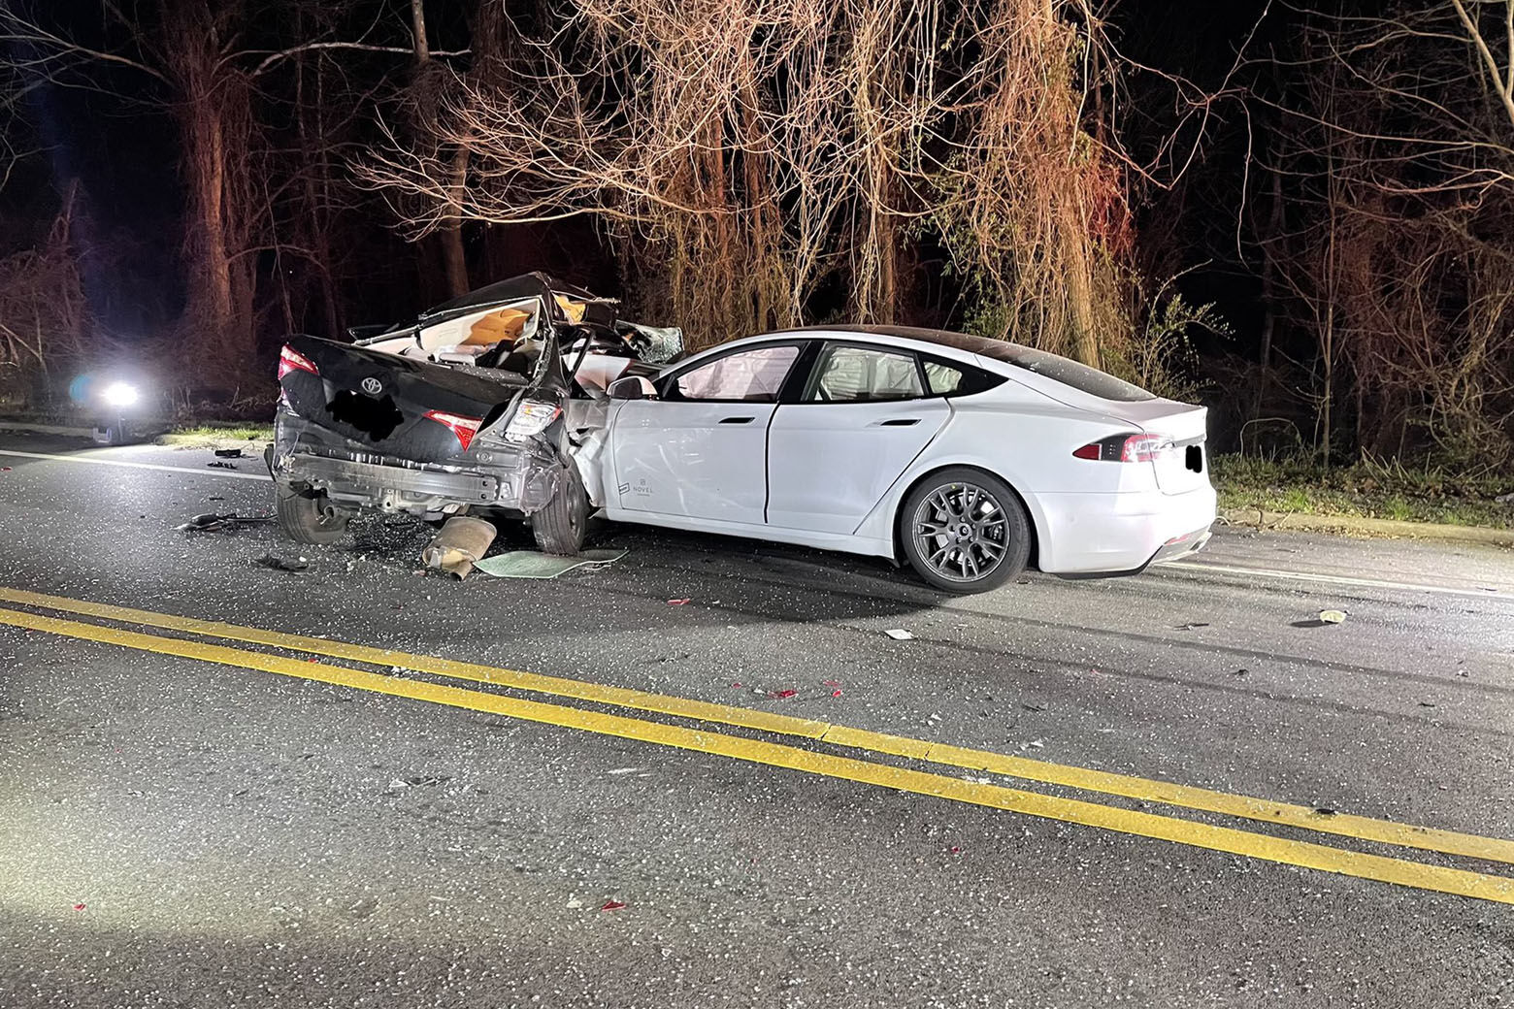
Fatal crashes in Maryland statewide
Frank Rodriguez
Michael Seman

Slide 2
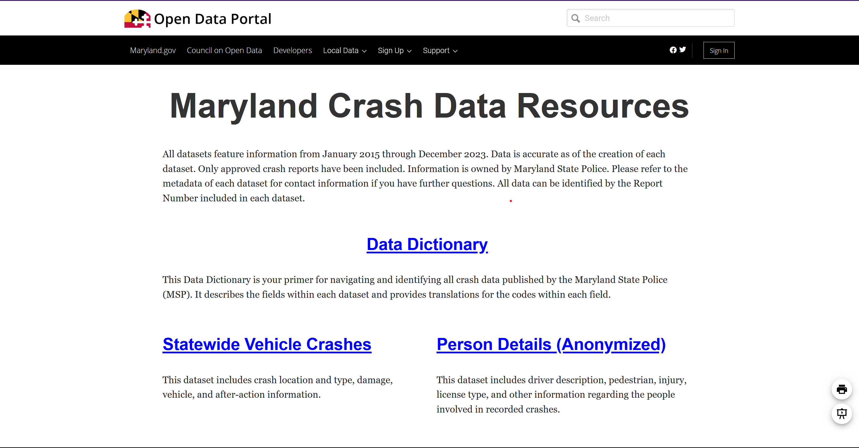

Slide 3
More was needed
Crashes
YEAR
QUARTER
LIGHT_DESC
COLLISION_TYPE
SURFACE_COND
Vehicles
DAMAGE_DESC
MOVEMENT_DESC
VEHICLE MAKE/MODEL
FIRE_FLAG
People
SEX_CODE
INJ_SEVER_DESC
ALCOHOL/DRUG TEST
EJECT_DESC

Slide 4
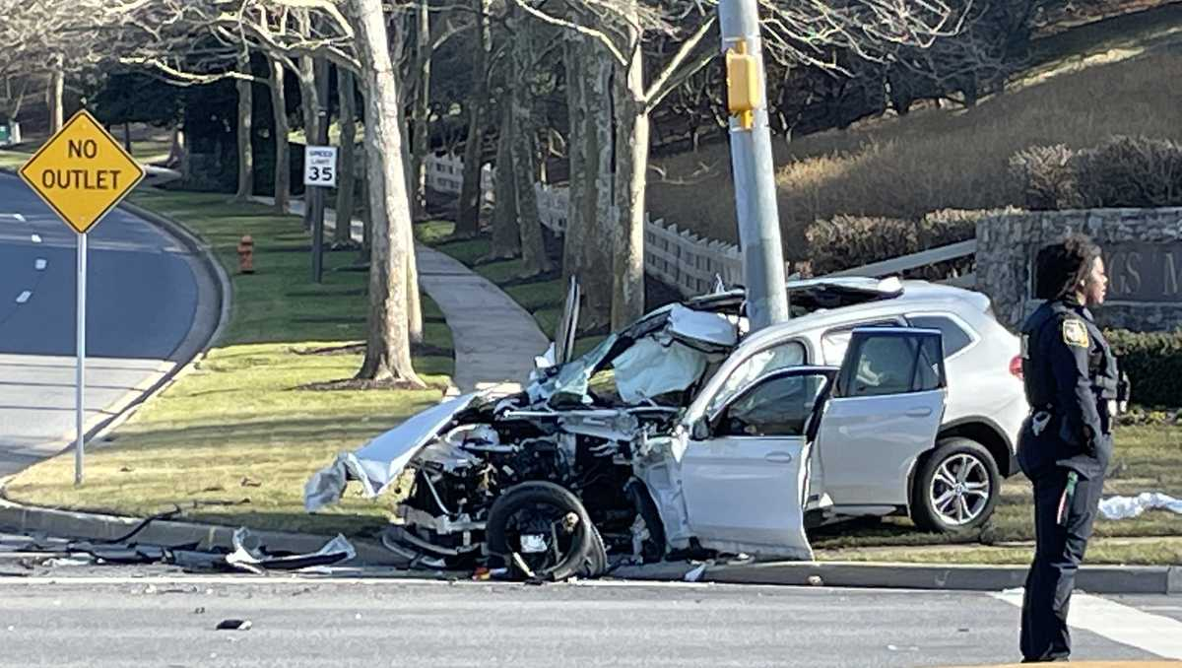
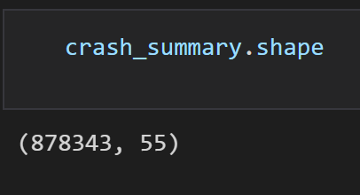
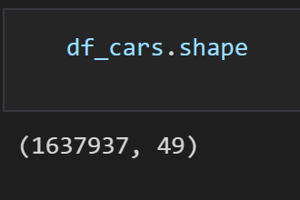
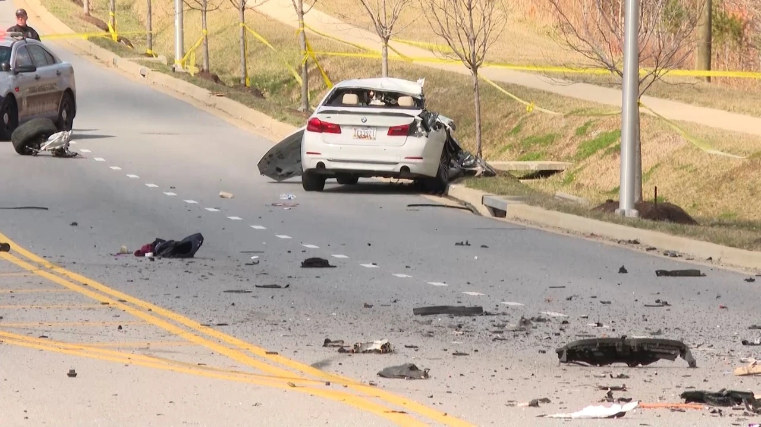
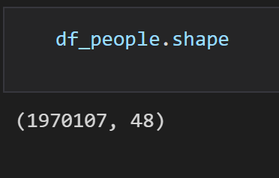
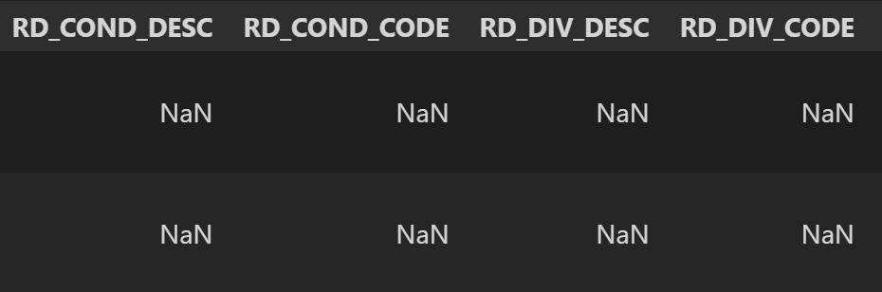
Datasets AT Start
150
Columns
4,486,387
rows

Slide 5
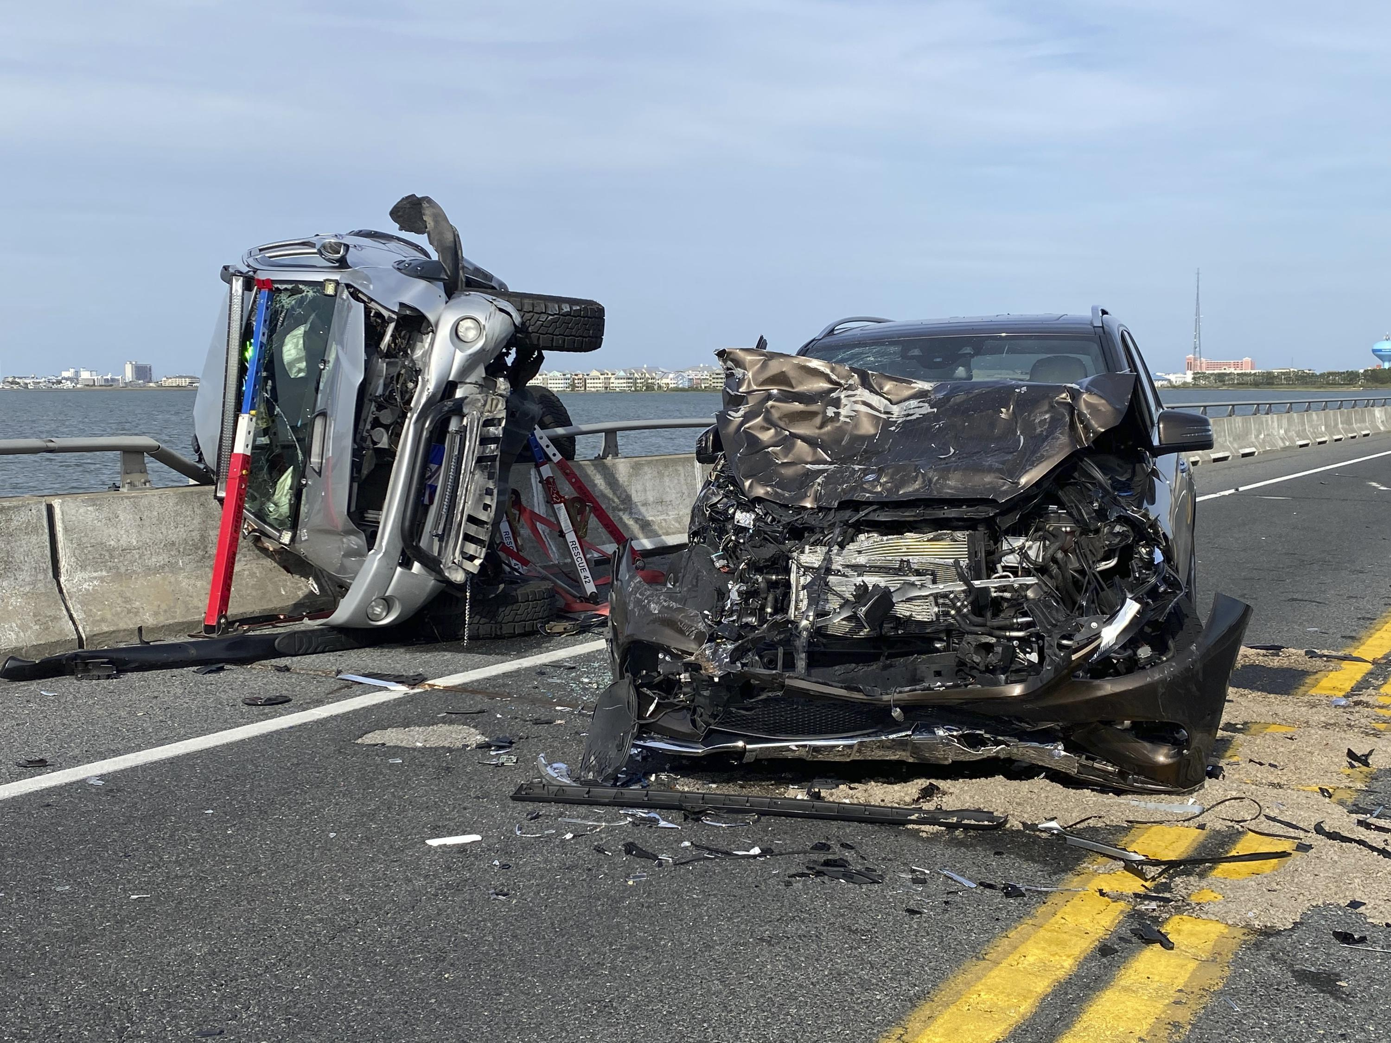
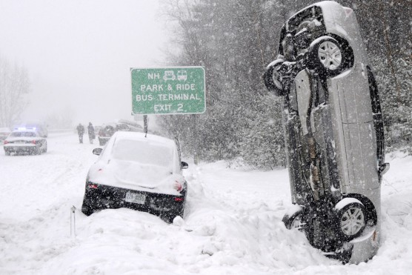
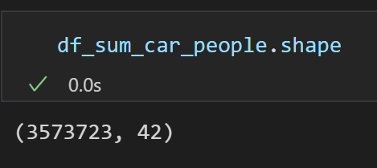
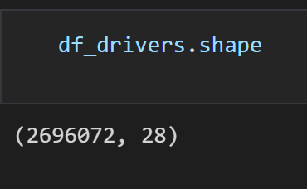
Datasets After Prep
42
Columns
3,573,723
rows
For Visualization
28
Columns
2,696,072
Rows
For ML

Slide 6
Statistical Tests
Cramer's V between LIGHT_DESC and REPORT_TYPE: 0.04382647814419923
Cramer's V between JUNCTION_DESC and REPORT_TYPE: 0.07463112233892347
Cramer's V between COLLISION_TYPE_DESC and REPORT_TYPE: 0.09867158024895727
Cramer's V between SURF_COND_DESC and REPORT_TYPE: 0.11899208651732575
Cramer's V between RD_COND_DESC and REPORT_TYPE: 0.056345261050202884
Cramer's V between RD_DIV_DESC and REPORT_TYPE: 0.06831573533715007
Cramer's V between FIX_OBJ_DESC and REPORT_TYPE: 0.08523267913659577
Cramer's V between WEATHER_DESC and REPORT_TYPE: 0.11781992648127863
Cramer's V between HARM_EVENT_DESC1 and REPORT_TYPE: 0.07359148553564526
Cramer's V between HARM_EVENT_DESC2 and REPORT_TYPE: 0.09953031352561843
Cramer's V between DISTANCE_DIR_FLAG and REPORT_TYPE: 0.06824237108536997
Cramer's V between DAMAGE_DESC and REPORT_TYPE: 0.13891628843576534
Cramer's V between COMMERCIAL_FLAG and REPORT_TYPE: 0.04092433802550119
Cramer's V between BODY_TYPE_DESC and REPORT_TYPE: 0.08596496479144486
Cramer's V between FIRE_FLAG and REPORT_TYPE: 0.03836024010985522
Cramer's V between PARKED_FLAG and REPORT_TYPE: 0.07128051351097567
Cramer's V between HIT_AND_RUN_FLAG and REPORT_TYPE: 0.08412899681352365
Cramer's V between MOVEMENT_DESC and REPORT_TYPE: 0.06394915125563126
Cramer's V between SEX_CODE and REPORT_TYPE: 0.0934049307864533
Cramer's V between CONDITION_DESC and REPORT_TYPE: 0.03039746044045404
Cramer's V between INJ_SEVER_DESC and REPORT_TYPE: 0.4720984762488296
Cramer's V between ALCOHOL_TEST_DESC and REPORT_TYPE: 0.049642143585528986
Cramer's V between DRUG_TEST_DESC and REPORT_TYPE: 0.04970365491256545
Cramer's V between FAULT_FLAG and REPORT_TYPE: 0.06391391442414701
Cramer's V between EQUIP_PROB_DESC and REPORT_TYPE: 0.05239037273267091
Cramer's V between EJECT_DESC and REPORT_TYPE: 0.1147217635707446
Cramer's V between AIRBAG_DEPLOYED and REPORT_TYPE: 0.11827280774931835

Slide 7
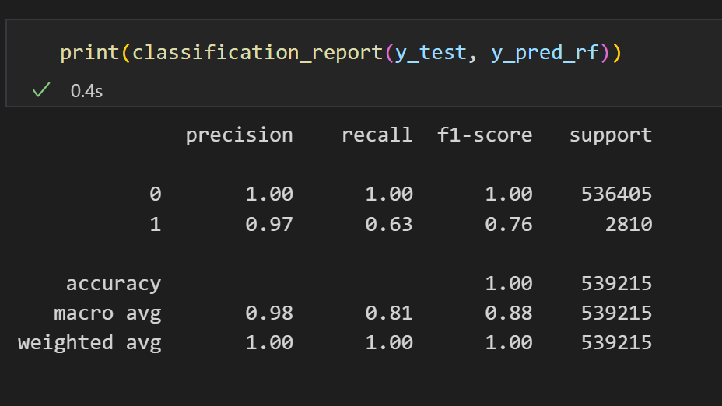
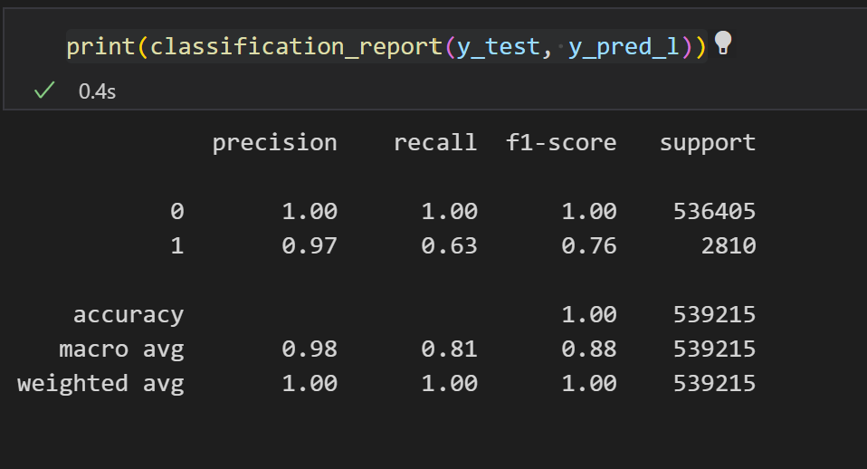

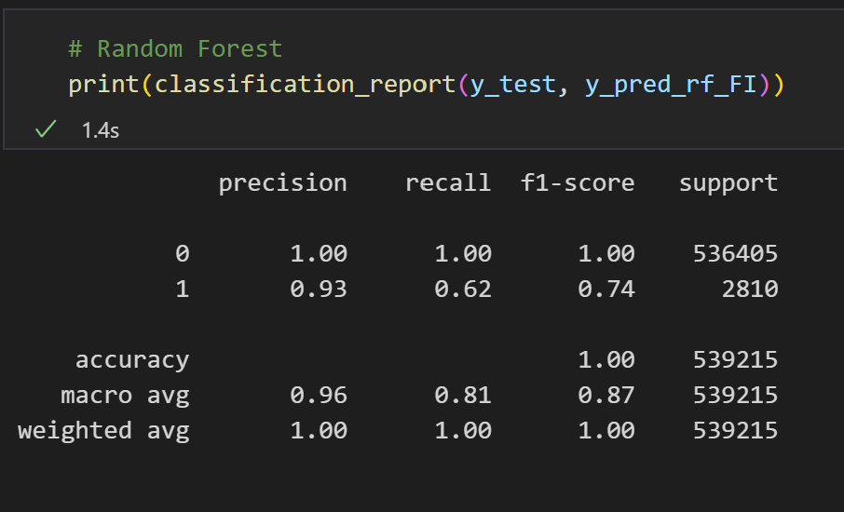
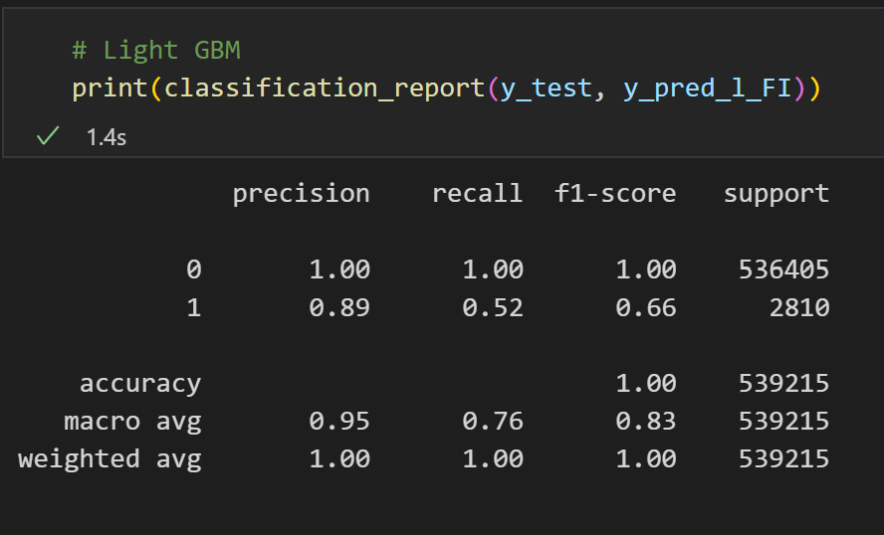
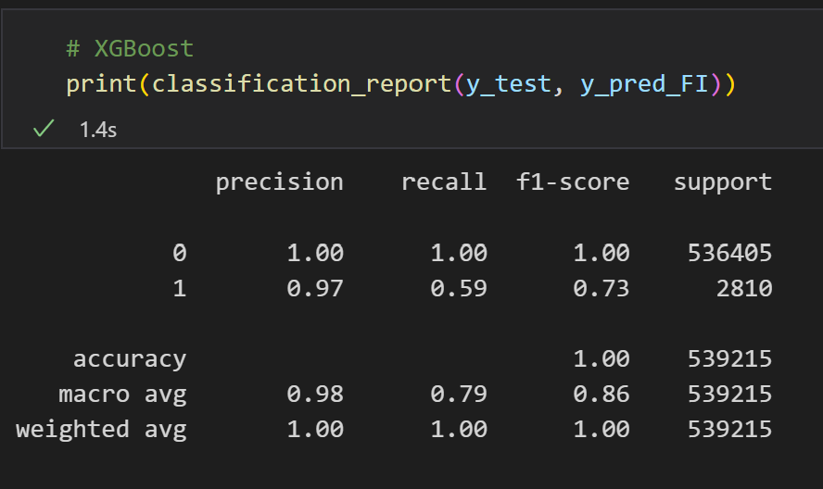
Results

Slide 8
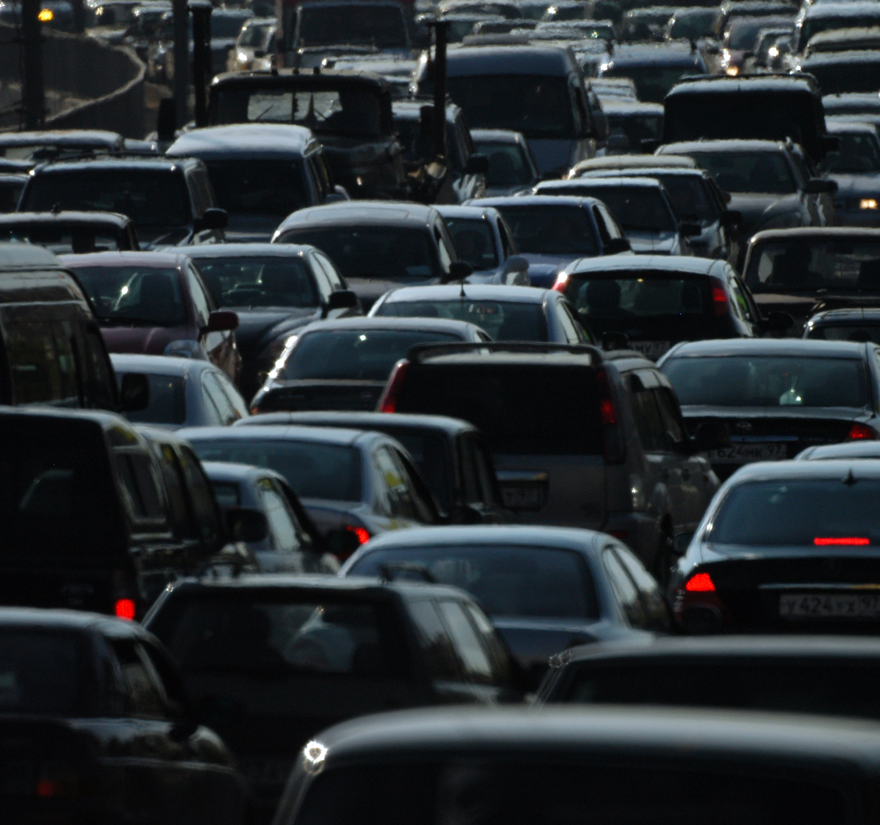
Maryland Fatal Crash Profile
Male
Ford, Passenger Car
North bound
Head on Collison
moving at constant speed
on a dry, defect free road
with a 55mph speed limit
October between 12pm-6pm
In Prince George’s County, on highway 95
Alcohol is not involved but increases chance of fatality

Slide 9
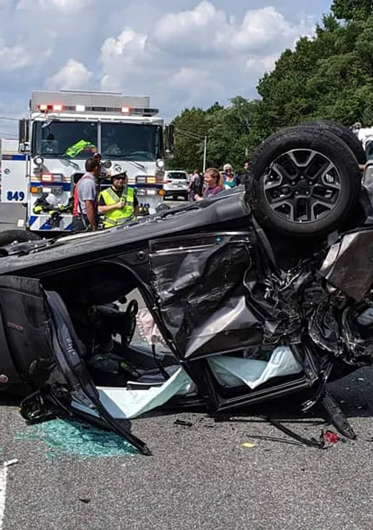
References https://catalog.data.gov/dataset?q= https://opendata.maryland.gov/stories/s/ggbs-m2rv

